Slide 1
CS 1520 COMPUTER ARCHITECTURE
Assembly Language

Slide 2
Memory Segmentation of Intel 8086

Slide 3
Memory Segmentation
The total memory size is divided into segments of various sizes.
A segment is just an area in memory.
The process of dividing memory this way is called Segmentation.

Slide 4
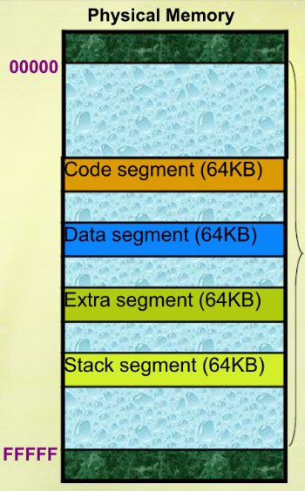
The complete physically available memory are divided into a number of logical segments
The CPU 8086 is able to address 1Mbyte of memory
The complete 1 Mbyte memory can be divided into 16 segments, each of 64 Kbytes size.
A segment may be located any where in the memory

Slide 5
Memory Segmentation
In memory, data is stored as bytes.
Each byte has a specific address.
Intel 8086 has 20 lines address bus.
With 20 address lines, the memory that can be addressed is 2²⁰ bytes.
2²⁰ = 1,048,576 bytes (1 MB).
8086 can access memory with address ranging from 00000 H to FFFFF H.

Slide 6
Simplified Segment Directives
TASM provides a simplified set of directives for declaring segments called simplified segment directives. To use these directives, you must initialize a memory model, using the .MODEL directive, before declaring any segment. The format of the .MODEL directive is:
.MODEL memory-model
The memory-model may be TINY, SMALL, MEDIUM, COMPACT, LARGE, HUGE or FLAT

Slide 7
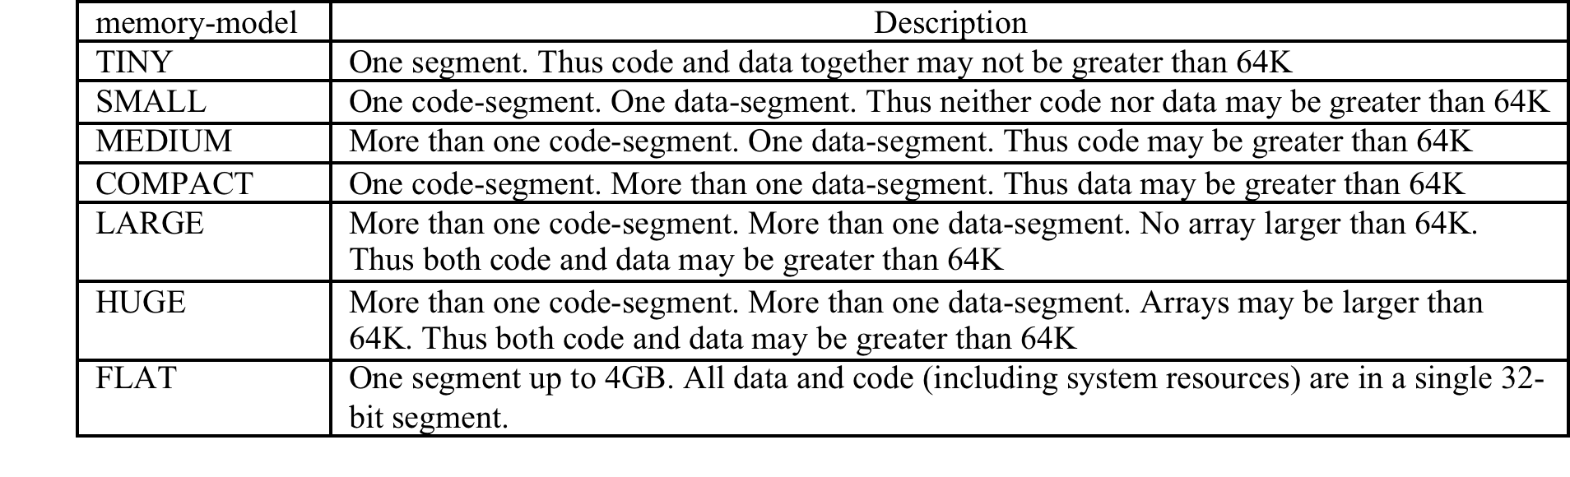

Slide 8
Memory Segmentation
In 8086, memory has four different types of segments.
These are:
Code Segment
Data Segment
Stack Segment
Extra Segment

Slide 9
Segment Registers
Each of these segments are addressed by an address stored in corresponding segment register.
These registers are 16-bit in size.
Each register stores the base address (starting address) of the corresponding segment.
Because the segment registers cannot store 20 bits, they only store the upper 16 bits.

Slide 10
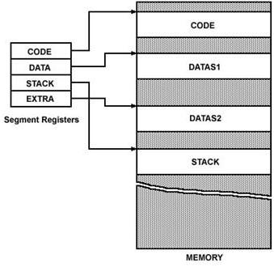
Segment Registers
CS, IP
DS
SS
SP

Slide 11
Segment Registers
The CS and IP registers are automatically initialized to point to the beginning of the code segment.
The SS register is initialised to point to the beginning of the stack segment.
The SP register is initialised to point one byte beyond the stack segment.
If a program contains a data segment, the DS register must be initialised by the programmer to point to the beginning of that data segment.
MOV AX, @DATA ; initialize DS
MOV DS, AX
The operating system will only initialise the CS, SS,SP and IP registers.

Slide 12
Initialisation of DS
The instructions which initialise the ds register
mov ax, @data
mov ds, ax
where ax may be replaced by any other 16-bit general purpose register.
At load time, @data is replaced with the 16-bit base address of the data segment.
@data evaluates to a constant value; such an operand is usually called an immediate operand.
An initialisation of the form:
mov ds, @data ; invalid !!
Such an initialisation is done indirectly using any 16-bit general-purpose register. Example:
mov ax, @data
mov ds, ax

Slide 13
Note: In a program, the data, code, and stack segments may appear in any order. However, to avoid forward references it is better to put the data segment before the code segment.
A programmer chooses an appropriate size for the stack segment, depending on the size of his program. Values in the range 100H to 400H are sufficient for most small programs.

Slide 14
Segment Registers
How is a 20-bit address obtained if there are only 16-bit registers?
The answer lies in the next few slides.

Slide 15
Segment Registers
How is a 20-bit address obtained if there are only 16-bit registers?
The answer lies in the next few slides.
The 20-bit address of a byte is called its Physical Address.
But, it is specified as a Logical Address.
Logical address is in the form of:
Base Address : Offset
Offset is the displacement of the memory location from the starting location of the segment.

Slide 16
Example
The value of Data Segment Register (DS) is 2222 H.
To convert this 16-bit address into 20-bit, the BIU (bus interface unit) appends 0H to the LSBs of the address.
After appending, the starting address of the Data Segment becomes 22220H.

Slide 17
Example (Contd.)
If the data at any location has a logical address specified as:
2222 H : 0016 H
Then, the number 0016 H is the offset.
2222 H is the value of DS.

Slide 18
Example (Contd.)
To calculate the effective address of the memory, BIU uses the following formula:
Effective Address = Starting Address of Segment + Offset
To find the starting address of the segment, BIU appends the contents of Segment Register with 0H.
Then, it adds offset to it.

Slide 19
memory
FFFFFH
….
….
Register
CS
DS 2222H
SS
ES
Offset = 16H
22220H
00000H

Slide 20
Example (Contd.)
Therefore:
EA = 22220 H
+ 0016 H
------------
22236 H
NOTE: this computation is in hexademical, not decimal

Slide 21
Example (Contd.)
2222 H
BYTE – 0
BYTE – 1
BYTE – 2
- - - - -
Addressed Byte
22220 H
DS Register
Offset = 0016 H
22236 H

Slide 22
Max. Size of Segment
All offsets are limited to 16-bits.
It means that the maximum size possible for segment is 2¹⁶ = 65,535 bytes (64 KB).
The offset of the first location within the segment is 0000 H.
The offset of the last location in the segment is FFFF H.

Slide 23
Where to Look for the Offset
Segment | Offset Registers | Function
CS | IP | Address of the next instruction
DS | BX, DI, SI | Address of data
SS | SP, BP | Address in the stack
ES | BX, DI, SI | Address of destination data (for string operations)

Slide 24
Question
The contents of the following registers are:
CS = 1111 H
DS = 3333 H
SS = 2526 H
IP = 1232 H
SP = 1100 H
DI = 0020 H
Calculate the corresponding physical addresses for the address bytes in CS, DS and SS.

Slide 25
Question
The contents of the following registers are:
CS = 1111 H
DS = 3333 H
SS = 2526 H
IP = 1232 H
SP = 1100 H
DI = 0020 H
Calculate the corresponding physical addresses for the address bytes in CS, DS and SS.
Segment | Offset Registers
CS | IP
DS | BX, DI, SI
SS | SP, BP

Slide 26
Question
The contents of the following registers are:
CS = 1111 H
DS = 3333 H
SS = 2526 H
IP = 1232 H
SP = 1100 H
DI = 0020 H
Calculate the corresponding physical addresses for the address bytes in CS, DS and SS.
Segment | Offset Registers
CS = 1111H | IP = 1232H
DS = 3333H | DI = 0020H
SS =2526H | SP = 1100H

Slide 27
Question
The contents of the following registers are:
CS = 1111 H
DS = 3333 H
SS = 2526 H
IP = 1232 H
SP = 1100 H
DI = 0020 H
Calculate the corresponding physical addresses for the address bytes in CS, DS and SS.
Segment | Offset Registers | Effective address
CS = 1111H | IP = 1232H | 11110H + 1234H
DS = 3333H | DI = 0020H | 33330H +0020H
SS =2526H | SP = 1100H | 25260H +1100H

Slide 28
Solution
1. CS = 1111 H
The base address of the code segment is 11110 H.
Effective address of memory is given by 11110H + 1232H = 12342H.
2. DS = 3333 H
The base address of the data segment is 33330 H.
Effective address of memory is given by 33330H + 0020H = 33350H.
3. SS = 2526 H
The base address of the stack segment is 25260 H.
Effective address of memory is given by 25260H + 1100H = 26350H.

